Slide 1
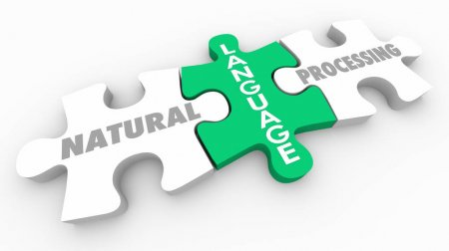
Reverse Mad Libs
Natural Language Processing
Scott Bing
https://www.quantilus.com/artificial-intelligence-explained-2-2/

Slide 2
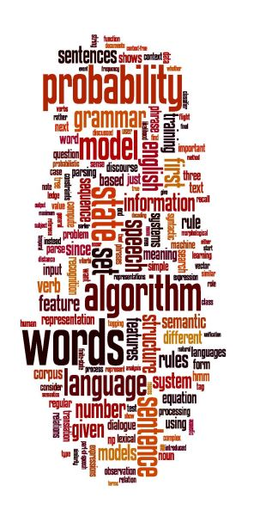
Reverse Mad Libs
Natural Language Processing
Scott Bing
https://web.stanford.edu/class/archive/cs/cs224n/cs224n.1162/handouts/MaxentTutorial-16x9-FeatureClassifiers.pdf

Slide 3
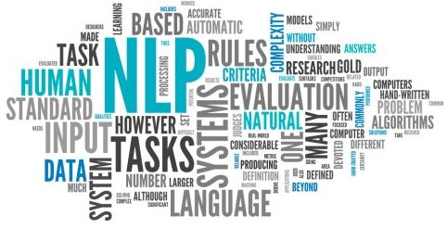
Reverse Mad Libs
Natural Language Processing
Scott Bing

Slide 4
Agenda
Introduction
What is Natural Language Processing
A Brief History of NLP
My Project: Reverse Mad Libs Game
Resources used
Questions

Slide 5
What is Reverse Mad Libs?
A twist on the popular game
Player one is asked for a list of arbitrary words
Player two inserts the words into a story
Player one typically does not see the story until the words are filled in
Machine uses NLP Algorithms to predict the missing words

Slide 6

Natural Language Processing
An attempt to meld human language with computer language.
Teach a computer how to converse with a human
Recognize human language
Computer converse with human

Slide 7

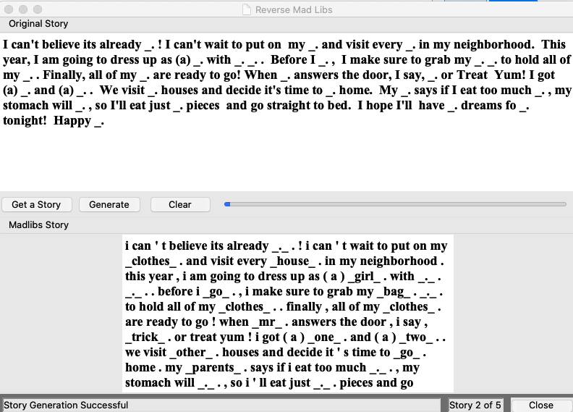
Reverse Mad Libs Application
https://www.amazon.com/Original-1-Mad-Libs/dp/0843100559

Slide 8

Project Resources
Python – Primary implementation Language
Pytorch - Python package for Data Science
Bert – Python NLP Package developed by Google
Tkinter – PythonPackage for GUI development

Slide 9

Improvements to the Application
Make substitution words more discernable
Allow the user to select stories from a local file system
Allow the user to edit the input text file
Provide a ‘Prepare” routine that randomly selects substitution locations
Investigate using a more robust trained dataset

Slide 10


Not this Bert
https://medium.com/@noa.kel/using-bert-with-pytorch-b9624edcda4e

Slide 11

The Google Search Conundrum

Slide 12
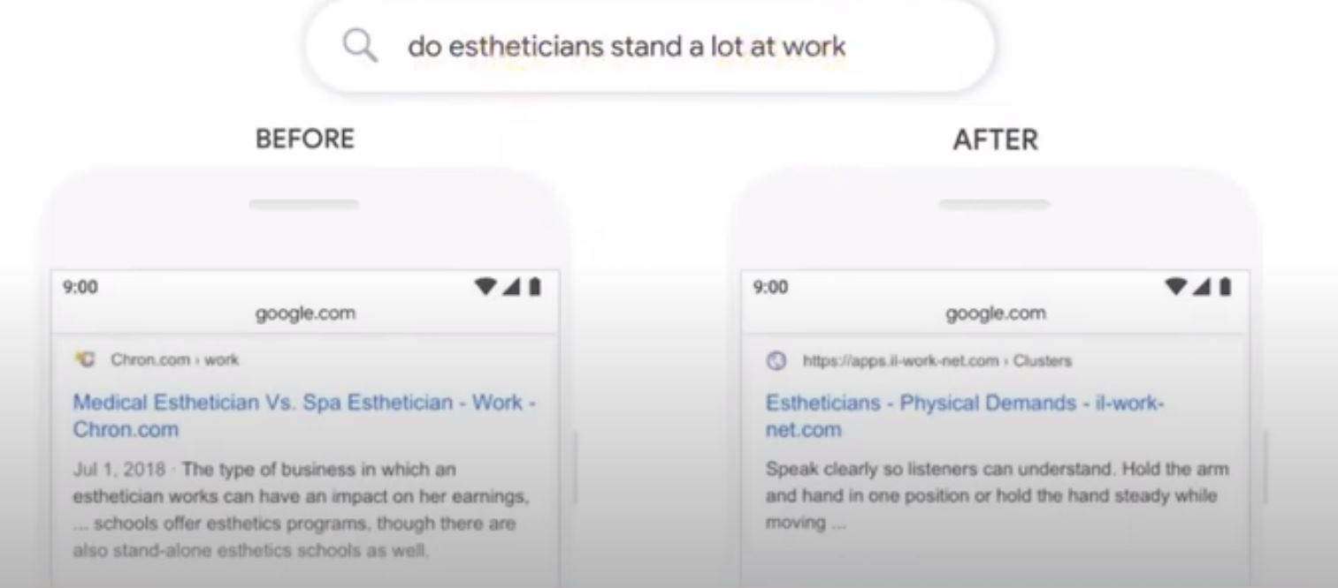
The Google Search Conundrum
https://www.lockedownseo.com/google-bert-update/

Slide 13

What is BERT?
Bidirectional Encoder Representations from Transformers
BERT is a Natural Language Processor facility
Developed by Google
A Transformer an object that holds the Encoder and Decoder
Key innovation is bidirectional scanning procedure

Slide 14
How Bert Works
Split text to tokens (words)
Break words into WordPieces
‘calling’ becomes ‘call’, ‘##ing’ ‘preview’ becomes ‘pre##’, ‘view’
Map words to indexes using a vocab file that BERT provides
Add special "CLS" and "SEP" tokens (see the readme) CLS is a beginning of the first sentence;.SEP is an end of sentence marker
Append "index" and "segment" tokens to each input
Creates a vector representation of each word

Slide 15
Tranformers
Connects word tokens to context
Composed of:
Encoder - decomposes txt to tokens
Decoder – connects words to context
Uses a continual internal training model
Words and sentences are masked forcing the transformers to predict the correct words and prhrases.

Slide 16
Training
BERT is pre-trained on a large corpus of unlabelled text including the entire Wikipedia(that’s 2,500 million words!)
and Book Corpus (800 million words).

Slide 17
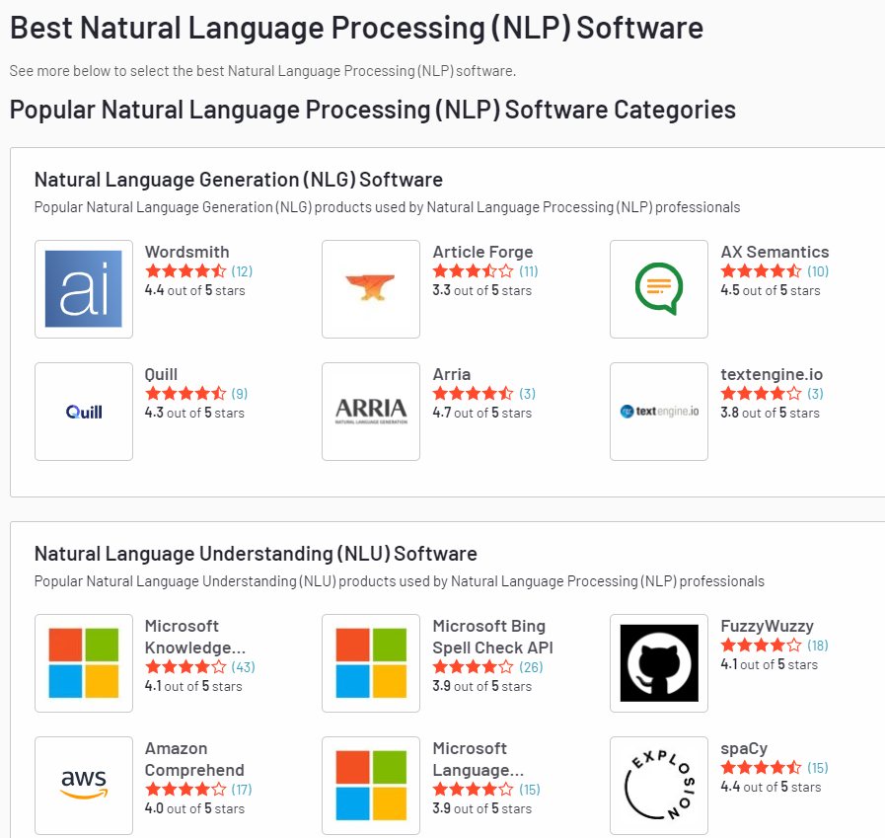
Other NLP Resources
https://www.g2.com/categories/natural-language-processing-nlp

Slide 18
Why did I choose Bert
Ease of installation and use
Unique Parsing Facility
Works well with Python

Slide 19

References
Roni Vorev, BERT Explained: State of the art language model for NLP
Sarthak Vajpayee, Understanding BERT — (Bidirectional Encoder Representations from Transformers)
Dipanjan Sarkar, Understanding Feature Engineering: Deep Learning Methods for Text Data
Jacob Devlin, Ming-Wei Chang, Kenton Lee, Kristina Toutanova, BERT: Pre-training of Deep Bidirectional Transformers for Language Understanding
Mohd Sanad Zaki Rizvi, Demystifying BERT: A Comprehensive Guide to the Groundbreaking NLP Framework
https://www.lockedownseo.com/google-bert-update/

Slide 20

Questions?

